Slide 1


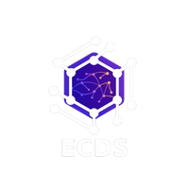


Decentralized Autonomous Healthcare
ECDS
DECENTRALIZED AUTONOMOUS HEALTHCARE
LOGISTICS NETWORK
TEAM NAME: DECODE NINJAS

Slide 2
ECDS
GUIDELINES
GitHub Submission: Submit your GitHub repository 8 hours before final evaluation.
Deployment: Deploy the complete project repository (frontend deployment optional).
Plagiarism Check: All submissions will undergo plagiarism verification.
Pitch Format: Round 1 & Round 2 will include a 7-minute project pitch + evaluation.
Team Requirement: Minimum 3 team members must be present during evaluation.

Slide 3
ECDS
PROBLEM STATEMENT:
Healthcare facilities need to transport critical medical supplies such as vaccines, medicines, blood packets, and diagnostic samples between manufacturers, distribution centers, blood banks, and hospitals. However, current logistics systems lack real-time tracking, transparency, and secure verification of deliveries, leading to delays, disputes, and risks in handling sensitive medical materials.

Slide 4
ECDS
INNOVATIONS:
Blockchain-Based Secure Medical Logistics
Smart Contract-Based Automated Delivery Management
Real-Time Tracking with Automated Alert System
AI-Based Provider Evaluation and Reputation System

Slide 5
ECDS
SOLUTION:
The hospital administrator submits a transport request with pickup location, delivery location, cargo type (vaccines), storage conditions, and delivery time.
A smart contract is created on the blockchain, and the request becomes visible to verified transport providers.
Transport providers send proposals with price, delivery time, vehicle details credentials.
The platform compares the proposals based on cost, reliability, and delivery time, and selects the best provider.

Slide 6
ECDS
The driver picks up the vaccines from the distribution center and confirms pickup through the mobile app, which is recorded on the blockchain.
The vehicle is tracked in real time, and alerts are sent if there are delays or route deviations.
At the hospital, medical staff verifies the delivery, and both driver and receiver confirm it digitally, creating a proof of delivery on the blockchain.
Finally, the smart contract automatically releases payment, and the system updates the reliability score of the participants.

Slide 7
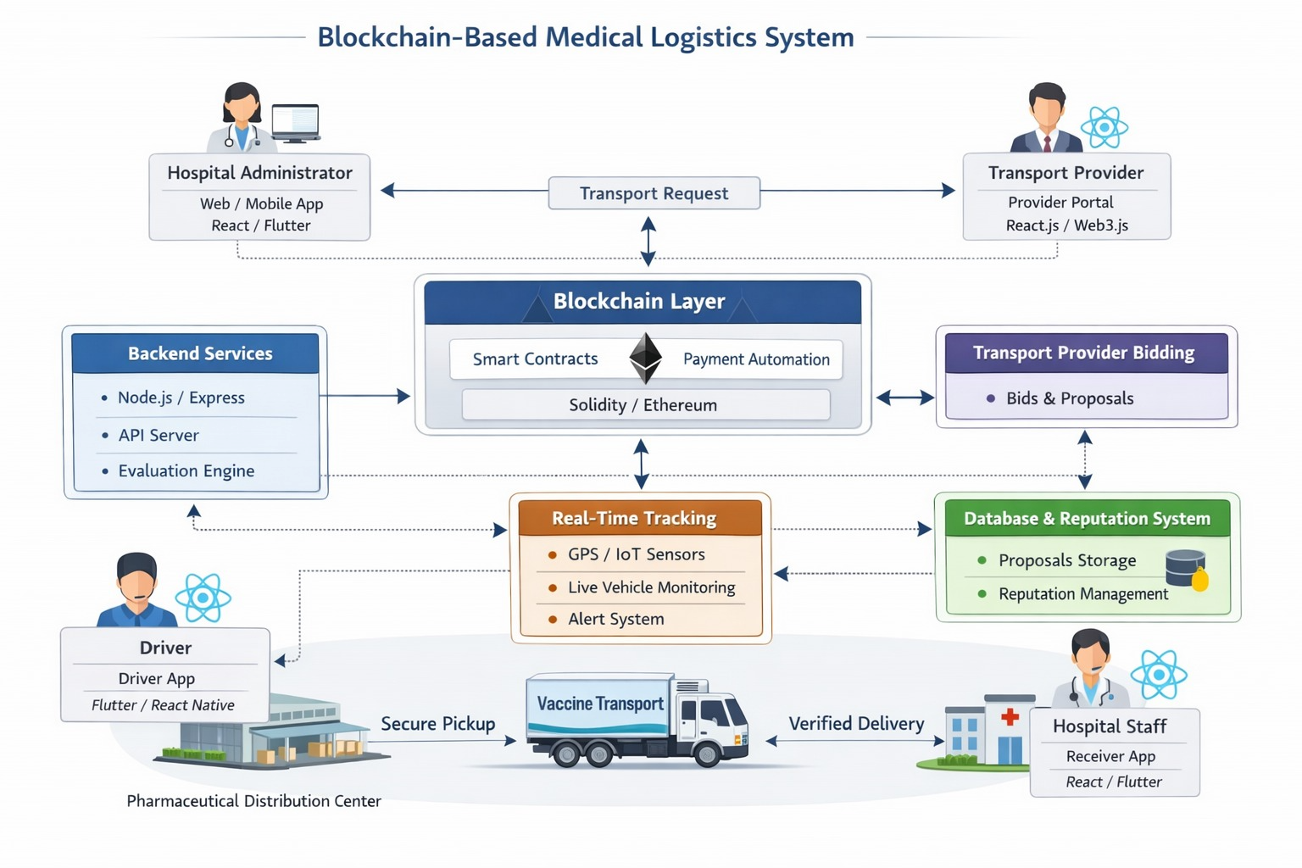
ECDS
WORKFLOW DIAGRAM:

Slide 8
ECDS
TEAM MEMBERS:
VENNAPUSA MALLIPUJITHA
SEGINENI VENKAT AKHILESH
KOTHA GNANA JAYADEEP
GUDI VISHNU VARDHAN

